Slide 1
WAD2 Team Project Design Spec
Lab 3 - Team D

Slide 2
Overview
The purpose of our web app is to provide a system to track extreme weather systems such as tornadoes, hurricanes or wild-fires. The app will provide an interactive map of these weather systems.
All users will be able to view the map, which will display pins at different locations where there are weather events. All users can click on the pin, which will provide them with information such as the location of the event and additional details.
There will be the option to create an account for the app, providing additional benefits. Logged in users will be able to add pins to the maps if they have details of an extreme weather event. Additionally, they will be able to add favourite locations to their account. If so, events near their favourite locations will be displayed on their feed.

Slide 3
Requirements
All users must be able to view the interactive map, and click on pins to view extreme weather events.
All users must have the ability to create/edit/delete an account.
Logged in users must be able to add a pin to the map, storing the location and details of an extreme weather event.
Logged in users should be able to add favourite locations to their account.
Logged in users should be able to view a feed of events that are happening in their favourite locations.
All users could sign in through third parties such as Facebook, Google etc…
Pins could have tags.
Logged in users could be able to comment on events.

Slide 4
Persona 1
Noah is a 28-year-old male from Texas. In his spare time, he enjoys travelling across the US, in search of tornadoes and other extreme weather events. He enjoys the thrill of being in a dangerous situation, and also taking photographs to remember his adventures. Time is of the essence when it comes to chasing storms, so he would like to have access to real time locations of storms. This would allow him to accurately track the movement of storms, so that he can make sure he is in the correct location at the correct time, making sure that he never misses an exciting storm again.

Slide 5
Persona 2
Sam is a 34-year-old volunteer fire fighter in the Blue Mountains, Australia. With the devastating fires throughout the summer, she wishes to be able to track the current locations of fires, so that she can be one of the first responders extinguishing them. It would be helpful if she were notified of any new fires which appear in the area she works. Additionally, she would like to be able to post locations of fires which she has come across, to ensure that the members of the public know to stay away from the danger and perhaps notify other firefighters of the blazes.

Slide 6
Persona 3
Derek is a 32-year-old banker who rides the 46-minute commute from Kentish Town to Canary Wharf on his bike, 5 days a week. As a cyclist, flooding can be a severe obstacle for him, so likes to keep track of flooding in his area. He would like to get real time updates from fellow commuters to avoid flooded routes. This will allow him to minimize the time taken for his daily commute, allowing him to spend more time with his family.

Slide 7
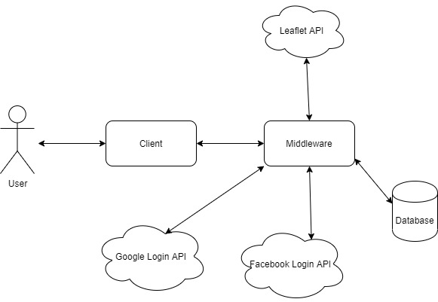
System Architecture

Slide 8
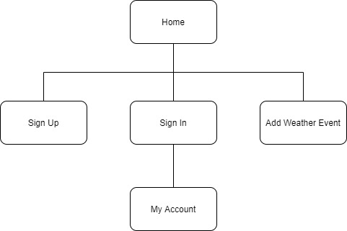
Site Map

Slide 9
ER Diagram

Slide 10
URLs
/home
/signup
/signin
/signin/myaccount
/addweatherevent

Slide 11
Wireframes

